Slide 1
Topic
Presentation on Full Stack Project
Book Inventory System
by
G-4
Ayush Kumar(2310990309)
Ansh Mehta(2310990287)
Aditya Mor(2310990267)
Supervised by: Rahul Sir
Department of Computer Science and Engineering, Chitkara University, Punjab

Slide 2
Table of Contents
Problem Statement
Objective / Purpose
Main Topics / Sections (Depends on your topic)
Future Scope
Conclusion
References (if applicable)
Q&A / Discussion

Slide 3
Problem Statement
With the expanding scale of libraries and bookstores, keeping manual records of book
stocks, issues, returns, and losses has become increasingly complex and error-prone.
Institutions face difficulties such as inaccurate book tracking, delayed identification of shortages or losses, inefficiency in stock audits, and poor data synchronization. The Book Inventory Management System transforms inventory operations by automating registration, circulation, reporting, and analytics, resulting in more precise, reliable, and effortless book management.

Slide 4
Objective / Purpose
Enhance Operational Efficiency: Digitize inventory processes to eliminate errors, ensure accurate records, and speed up book registration and circulation.
Empower Staff and Users: Provide real-time access to book status, streamline check-in/check-out, and automate notifications for dues and losses.
Improve Decision-Making: Enable data-driven forecasting, reduce overstock/loss, and improve acquisition planning with actionable analytics.
Strengthen Security and Compliance: Control access, audit every action, and assure the safety of valuable book collections.
Facilitate Growth: Ensure the system can scale and integrate with digital content systems, cross-branch networks, and e-book solutions.
,

Slide 5
Main Topics / Sections
User Centric Design
Responsive web interfaces allow staff and users to navigate the inventory system on any device. Profiles for books and users are cleanly organized, searchable, and editable for efficient operations.
2. Efficient Backend Architecture
A Node.js/Express.js-powered backend handles business logic, inventory transactions, permission checks, and API endpoints. Architectural decisions focus on performance, reliability, and scalable session management.
3. Secure and Scalable Database
All inventory, user, and transaction data are stored in a MongoDB (or similar) database. Data structures are optimized for speedy search, bulk imports, and secure multi-user access.

Slide 6
Main Topics / Sections
4. Advanced Features Implementation
Includes dynamic search/filtering of books, transaction logs, loss/damage reporting, barcode integration, and real-time alerts for inventory changes or overdue returns.
5. Role-Based Administration & Analytics
Admins can manage users, generate in-depth usage/stats reports, and resolve book/location mismatches. Integrated dashboards support actionable decisions.
6. Robust Testing and Deployment
Thorough system testing ensures smooth operations, security, and scalability. Automated deployments and cloud hosting enable high availability.

Slide 7
Future Scope
1.Integration with E-Book Lending for hybrid libraries.
2.AI Analytics: Automated demand forecasting and anomaly detection.
3. Mobile Access & Barcode Scanning: Inventory management from shelf to system using handheld devices.
4.Inter-Branch Networking: Seamless sharing and management of book data across locations.

Slide 8

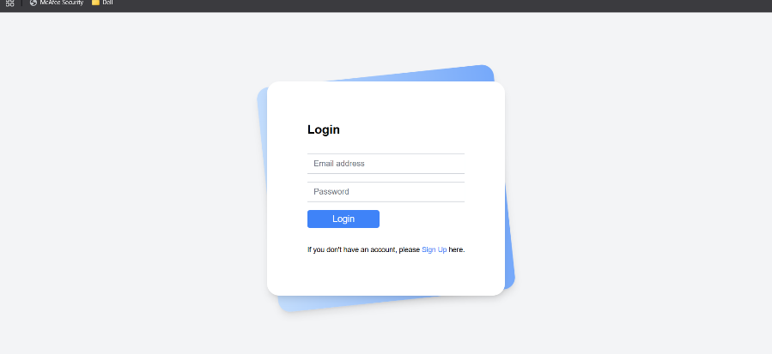
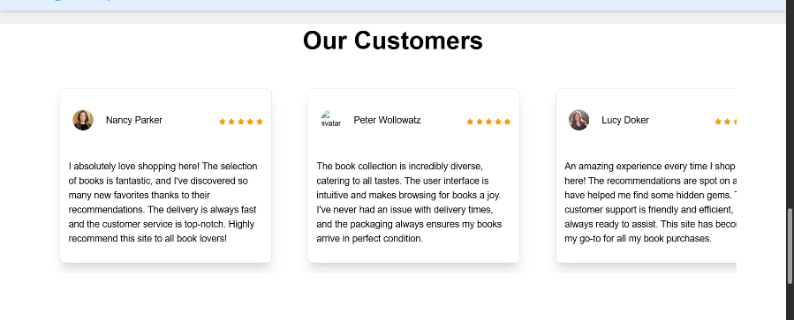
Project Snippets

Slide 9
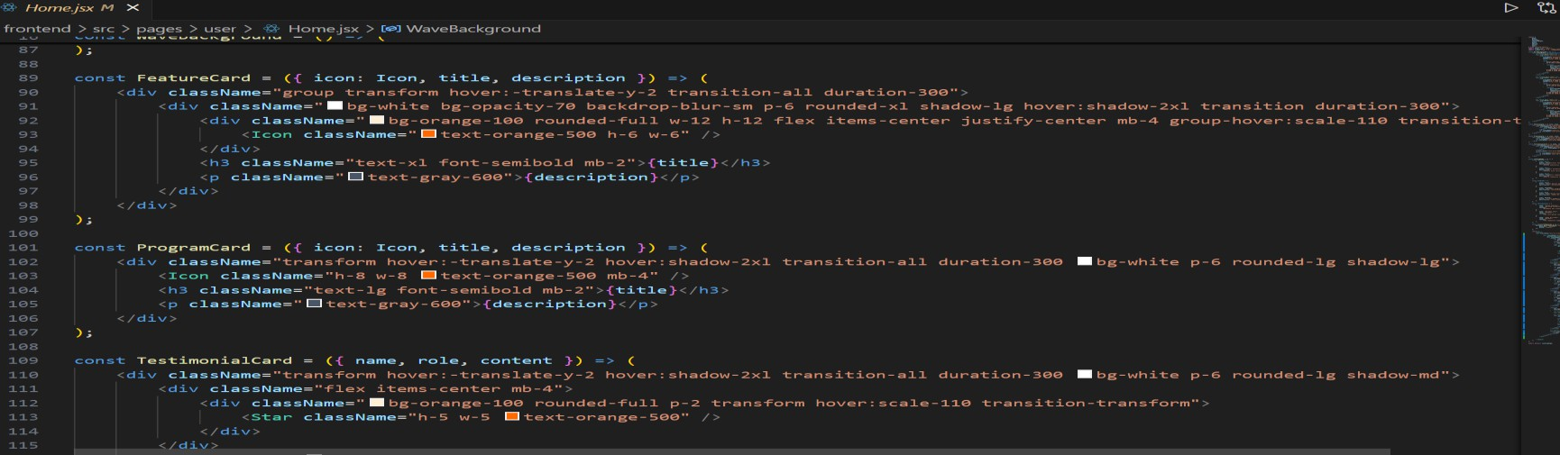
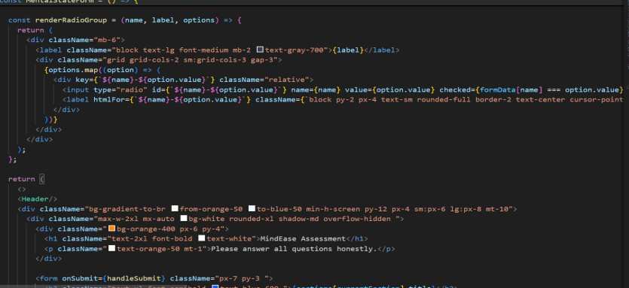
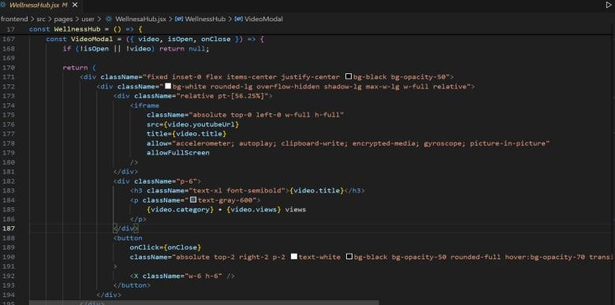
Code Snippets

Slide 10
Conclusion
The implementation of a robust Book Inventory Management System is critical
for any organization dealing with tangible book assets, including libraries,
bookstores, and educational institutions. This system offers a transformative
shift from error-prone manual inventory practices to streamlined, efficient, and
data-driven management processes. By automating key workflows such as
book registration, circulation tracking, loss and damage reporting, and real
-time stock auditing, the system not only minimizes the risks of overstocking
and stockouts but also optimizes storage utilization and operational costs.

Slide 11
References
Patel, U. V., & Solanki, P. (2025). Book Store Application with Inventory Management. International Journal of Research Publication and Reviews, 6(3), 9094-9098. This study explores architecture, features, and AI integration in modern bookstore inventory systems, emphasizing operational efficiency and customer satisfaction.
Irmawan Rahyadi et al. Evaluating A Library Automation System Application in Senayan Library Management System (SLiMS): The Human Organization Technology (HOT) FIT Model in Indonesia. The paper discusses best practices for library automation and inventory control.
Research on Inventory Management Systems (2021). IJSRET Journal. Focus on efficient tracking of purchase orders and inventory records to optimize stock levels.
Mabeifam, M. U., et al. (2023). A Proposed Multi-Channel System for Public Libraries in Bangladesh. Highlights inventory control challenges and solutions in large-scale library networks.

Slide 12
Q&A / Discussion
Ensuring Data Consistency:
Challenge: Avoiding duplicate entries and ensuring accurate location tracking.
Solution: Used unique constraints and validation in the backend and indexed book/location data for speed and accuracy.
Bulk Operations:
Challenge: Handling large-scale imports/exports and data migration.
Solution: Added robust CSV parsers, transaction rollbacks, and pre-insertion verification functions.

Slide 13
Q&A / Discussion
Security and Access Control:
Challenge: Preventing unauthorized actions or data manipulation.
Solution: Deployed JWT authentication and role-based permissions for all critical operations.
Inventory Loss/Fraud Detection:
Challenge: Quickly identifying lost or misplaced inventory.
Solution: Used status tracking, alerts, and automated discrepancy reports.

